Slide 1
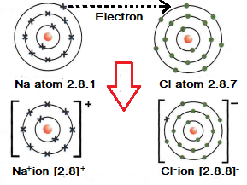
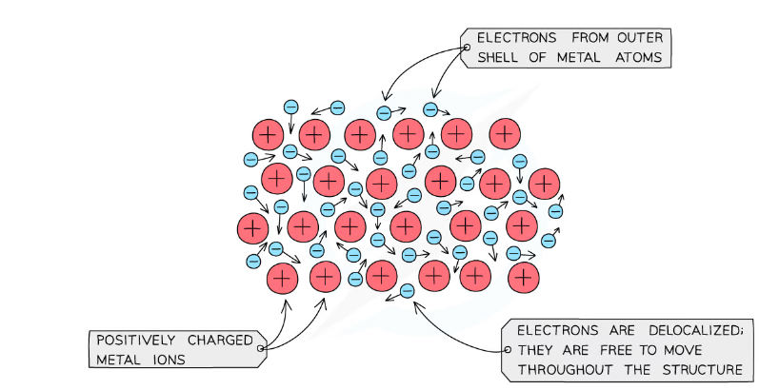
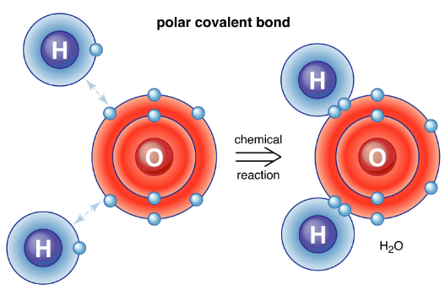

C2 Bonding and Structure
Ionic bonding is the complete transfer of valence electron(s) between atoms. It is a type of chemical bond that generates two oppositely charged ions. In ionic bonds, the metal loses electrons to become a positively charged cation, whereas the nonmetal accepts those electrons to become a negatively charged anion.
Gene | A short section of DNA that contains the instructions for one characteristic e.g. eye colour. Genes code for proteins. Genes are found on chromosomes.
Chromosome | Found in the nucleus. Made out of DNA. Humans has 46 chromosomes.
Genome | The entire genetic material of an organism.
Allele | Two versions of the same gene, one from each parent.
Phenotype | The physical characteristics of an organism.
Genotype | An organism’s complete set of genes.
Asexual reproduction | Reproduction involving one parent, giving genetically identical offspring (clones).
Sexual reproduction | Involves two parents. Produces variation in the offspring.
Meiosis | Cell replication that produces four non-identical haploid cells from one diploid cell
Homozygous | Two of the same alleles, either two dominant or two recessive.
Heterozygous | Two different alleles, one dominant and one recessive.
Dominant | An allele that is always expressed, even if only one copy is present.
Recessive | An allele that is only expressed if no dominant alleles are present.
A covalent bond is a shared pair of electrons. Covalent bonding results in the formation of molecules or giant structures. Substances with small molecules have low melting and boiling points and do not conduct electricity. Giant covalent substances have very high melting points.
Metallic bonding
Metals form giant structures in which electrons in the outer shells of the metal atoms are free to move. The metallic bond is the force of attraction between these free-moving (delocalised) electrons and positive metal ions. Metallic bonds are strong, so metals can maintain a regular structure and usually have high melting and boiling points.

Slide 2
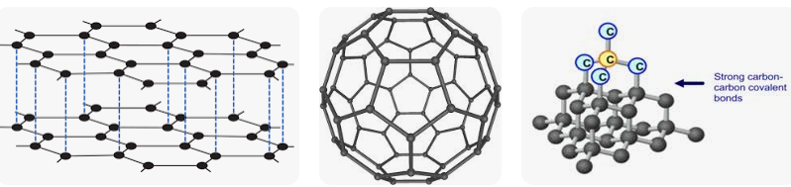
C2 Bonding and Structure
C2 (Useful websites)
https://wwwhttps://www.youtube.com/watch?v=C-huBrgQr2U .savemyexams.co.uk/igcse/chemistry/edexcel/19/revision-notes/1-principles-of-chemistry/1-8-metallic-bonding/1-8-1-metallic-bonding/ https://www.youtube.com/watch?v=70dOzvhn-8M https://quizlet.com/gb/352806116/giant-covalent-structures-structure-and-bonding-chemistry-year-10-gcses-diagram/ https://www.bbc.co.uk/bitesize/guides/zjfkw6f/revision/5
Giant covalent structures
A small number of covalent substances form giant structures instead of small molecules. In these structures, the atoms are bonded to each other with covalent bonds.
Examples
Silicon dioxide, also called silica, is the main compound found in sand. It is an example of a substance with a giant covalent structure. It contains many silicon and oxygen atoms.
All the atoms in its structure are linked to each other by strong covalent bonds. The atoms are joined to each other in a regular arrangement, forming a giant covalent structure. There is no set number of atoms joined together in this type of structure.
Diamond is another example of a giant covalent structure. Diamond is made up of carbon atoms - it is a form of carbon.
Nanoparticles are materials with overall dimensions in the nanoscale, ie, under 100 nm. In recent years, these materials have emerged as important players in modern medicine, with applications ranging from contrast agents in medical imaging to carriers for gene delivery into individual cells.
Titanium dioxide in nanoparticle form is used in sunscreens as it blocks UV light but leaves no white marks on the skin while also providing better coverage than other suncreams
The same chemical in bulk form is used as a white pigment in paints
Fullerenes are used in medicine and drug design as they are more easily absorbed than other particles and can deliver drugs to target areas more effectively
Fullerenes are also used in electronic circuitry and as coatings for artificial limbs and joints
Nanoparticles of silver are sprayed onto the fibres of medical clothing and surgical masks which gives them the flexibility of a material but with the added benefit of the antibacterial properties of silver metal

