Slide 1
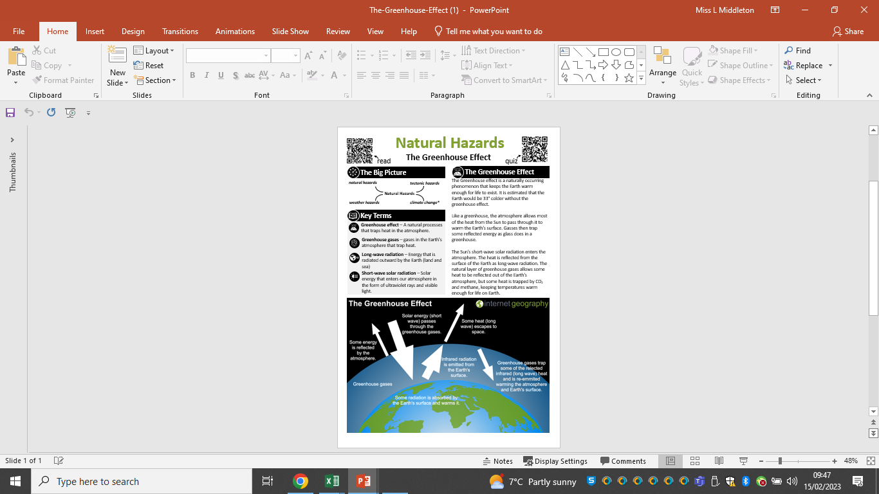
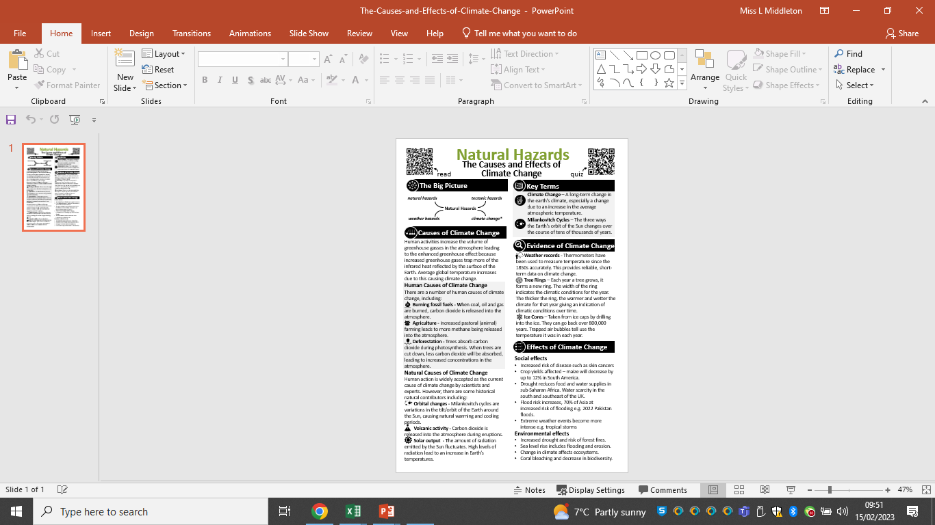

Year 10 Term 2B: Climate Change Maximise Sheet
Core Knowledge

Slide 2
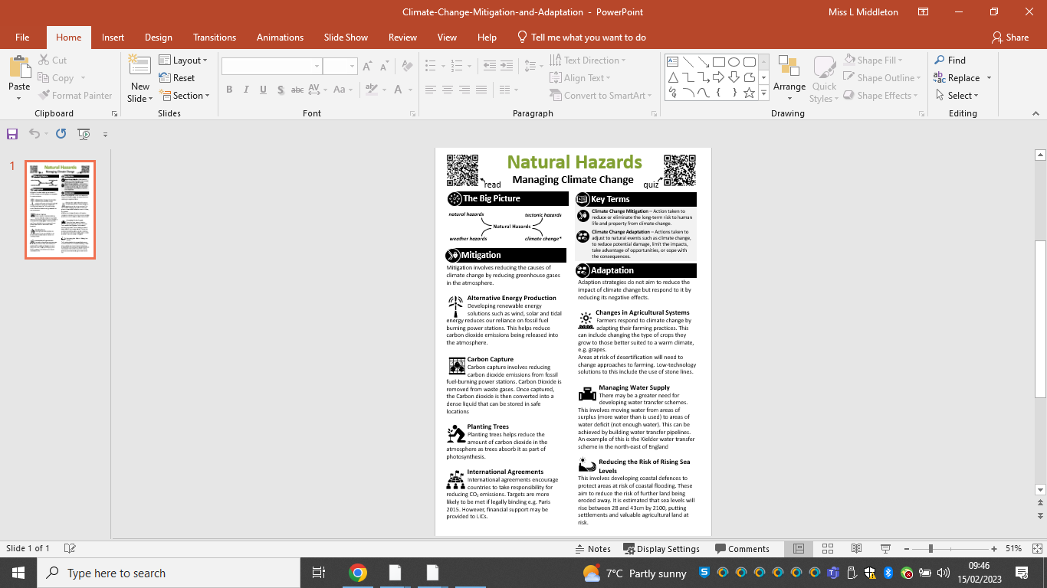
AM I READY TO MOVE ON? KEY QUESTIONS.
(Tip: You could use these questions to help with your mind map!)
Give one natural cause of changes in global temperature.
Give two pieces of evidence, other than changes in global temperature, that show climate change has taken place.
Explain how the increasing use of fossil fuels and changes in agriculture may have contributed to global changes in temperature.
Explain how ice cores provide evidence for past climate change.
Explain how eccentricity can lead to changes in climate.
‘Humans are to blame for climate change’ To what extent do you agree with this statement?
Managing climate change involves both reducing causes and responding to change. To what extent do you agree with this statement?
KEY QUOTE
“Geography isn’t just reading maps – It is knowing how the world works” – F Steiner

