Slide 1

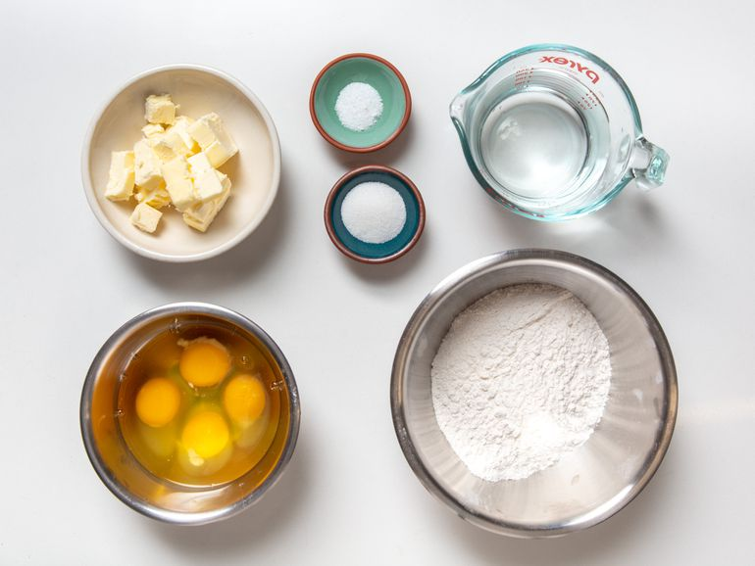
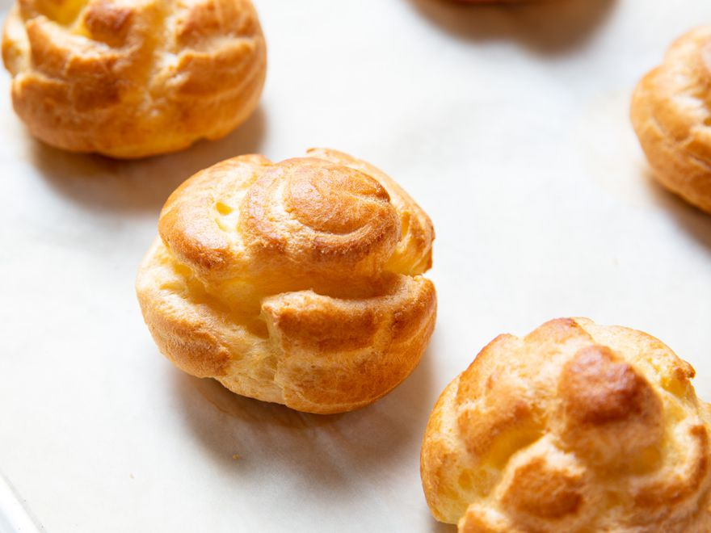

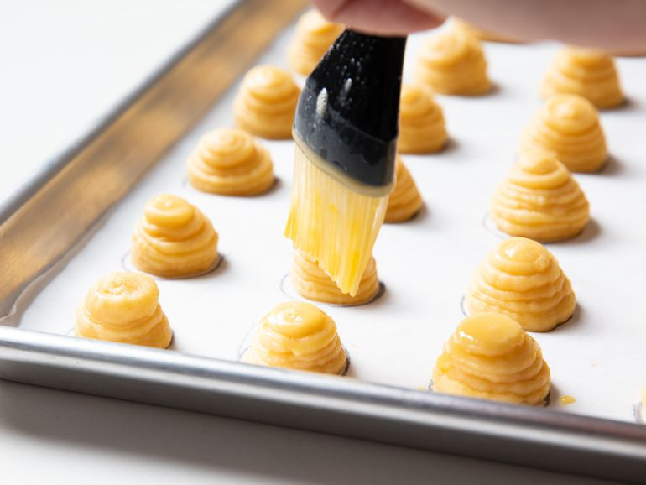
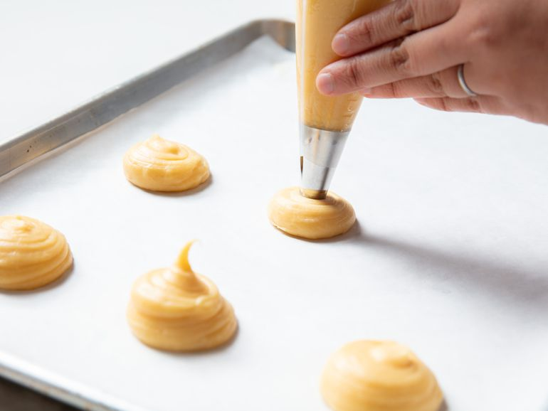
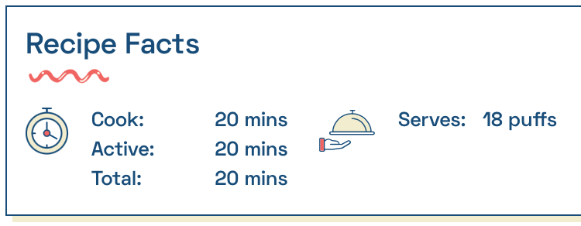
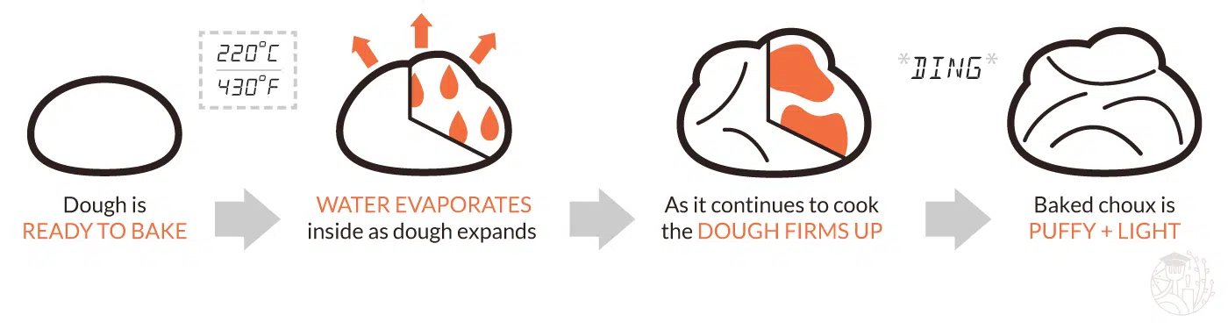
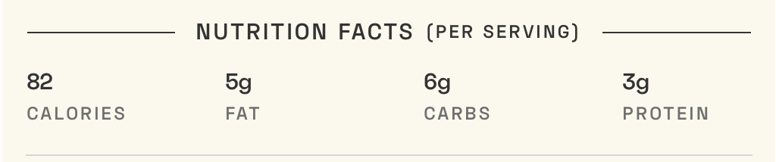
BECOMING AN EXPERT ON BAKING
In your food technology lessons you are making bread and pastries. To become an expert you should be able to make pasties using only 4 ingredients and develop your own pastry using the method below. Using the method and ingredients make your own choux pastry.
The Key Techniques for Choux Success
The Ratios: Fat and flour needs to at 50/50 ratio/ E.g. 100g flour use 50g butter.
Cooking the dough: It's All About Temperature: only add eggs when dough isn’t too hot and on stove
Adding water to the baking tray and water to generate steam needed for inside the choux pastry.
Also adding water on the choux pastry tips which stops it from burning.
EQUIPMENT FOR DOUGH
Saucepan
Spoon
Mixing bowl
Measuring scale
Baking tray
PASTRY MAKING
Pipping bag
Nozzle
Check your knowledge and understanding?
Why do we use plain flour for baking choux pastry?
What is the function of flour in a pastry?
List an important reason why water is needed on the baking tray when baking choux pastry?
What’s the best way to add flour once your salt, water sugar and butter have mixed together?
how long do you need to allow your dough to rest before baking?
What happens when your dough is resting?
INGREDIENTS
1 cup (235g) water or milk
6 tablespoons (84g) unsalted butter, cut into cubes
2 teaspoons (8g) sugar
1/2 teaspoon (2g) salt
128g all-purpose flour, sifted
4 large eggs (200g)
What happens during baking?
Once the choux pastry has entered the oven, various things will start to happen. First of, the dough will warm up. The butter melts, softening the dough. As a result, the dough becomes more flexible.
After some time, when the dough is hot enough, water within the choux starts to evaporate. The water turns into a gas. This gas will try to escape the choux pastry. However, it can’t because it is surrounded by a flexible, but impenetrable outer shell. So, instead, the gas just pushes onto the dough, causing it to puff up. This process takes some time. As long as the dough is flexible enough, it will continue to expand.
METHOD
Measure all ingredients and begin with bringing the water, butter, salt and sugar to a boil.
Take the pot off the heat and fully mix in flour. Once it’s combined and smooth, the mixture goes back on the heat.
First you want to let your dough cool down before adding the eggs, since there's a risk of cooking them prematurely if they are added while still the dough is still hot.
At this point, you can safely let the choux rest at room temperature for up to a couple hours before using.]
Glaze with water
Use pipping bag to make your pastry
WEBSITE ADDRESS
https://www.seriouseats.com/choux-pastry

Slide 2
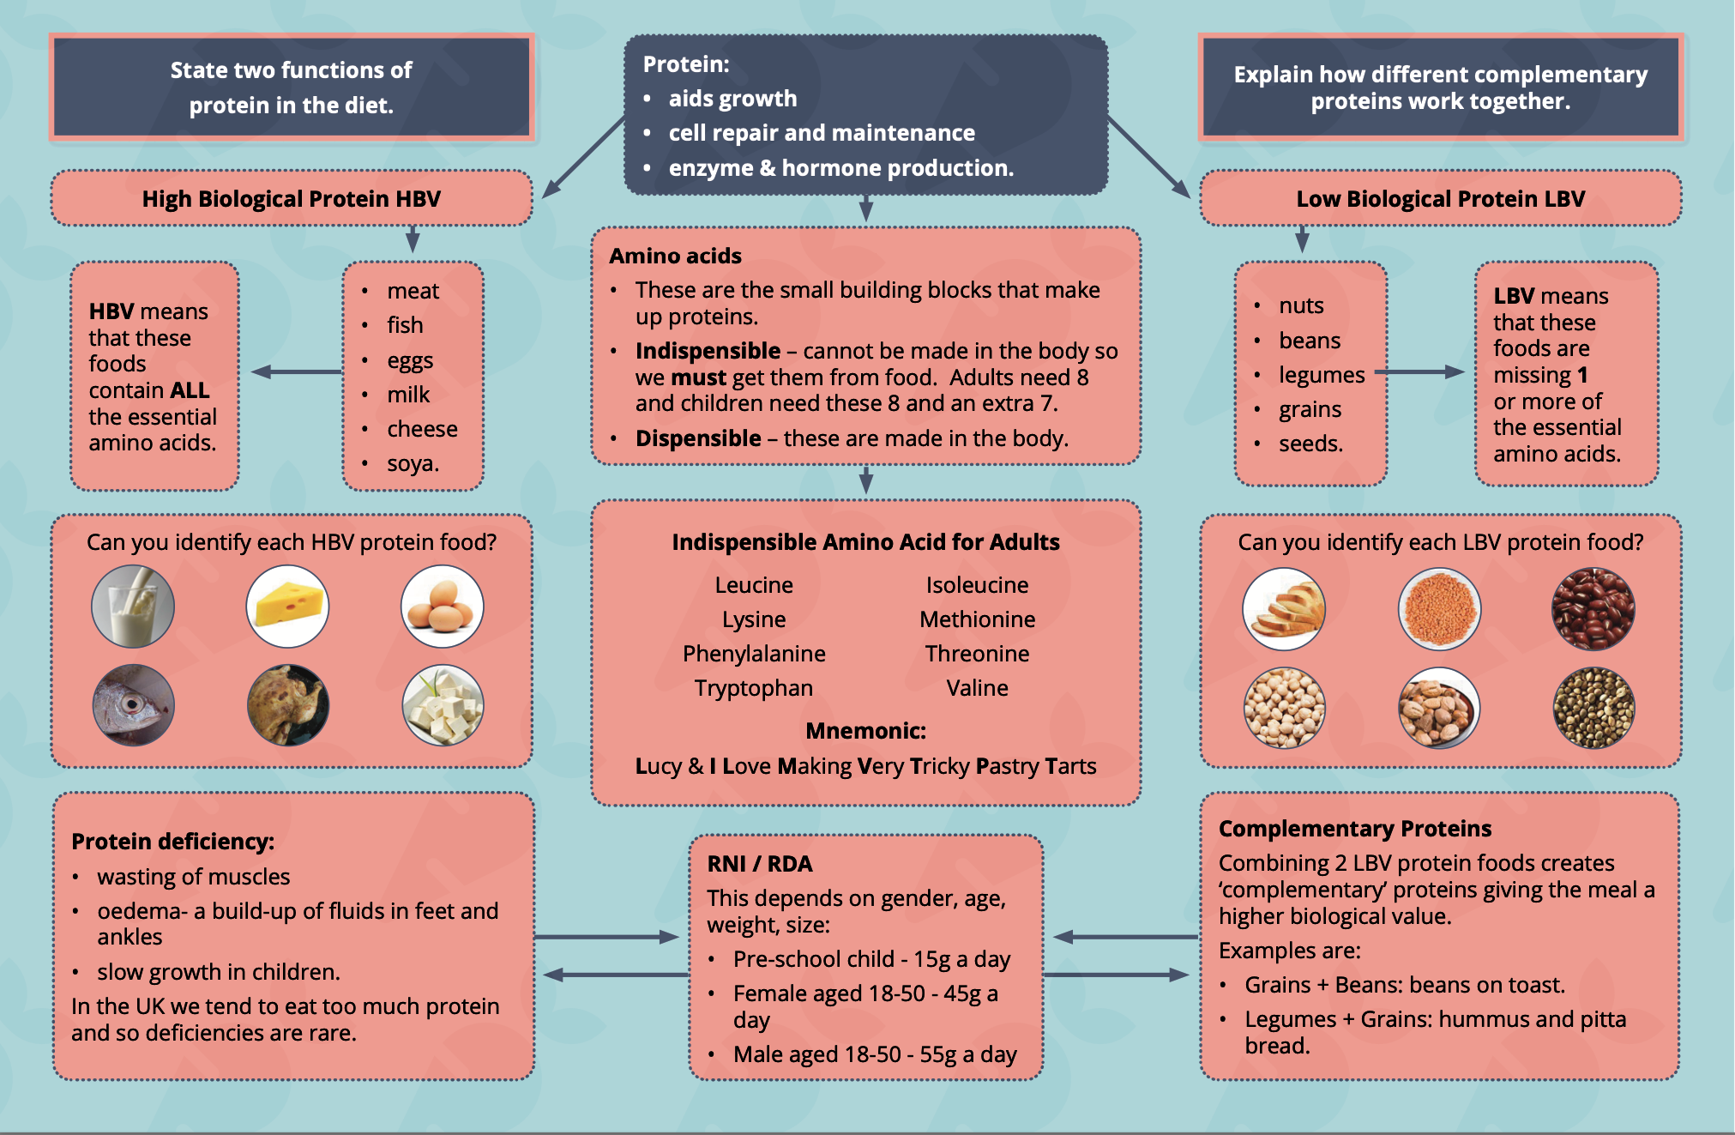
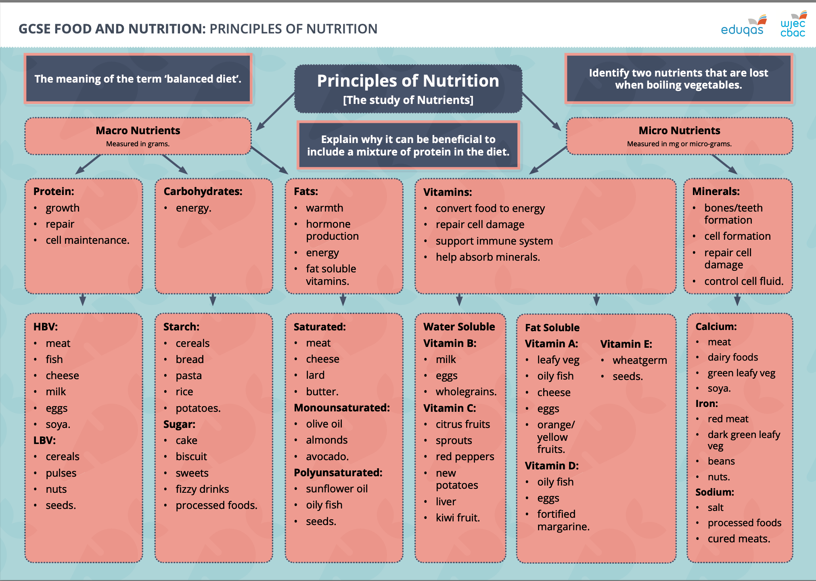
BECOMING AN EXPERT ON NUTRITION
CARBOHYDRATES WHOLEGRAIN & NUTRIENTS
Wholegrains provide:
fibre –soluble and insoluble
B vitamins and folic acid
essential fatty acids (omega 3)
protein
antioxidants including vitamin E, selenium / trace elements such as copper.
Types of wholegrains
Cereals:
Wheat, including spelt and durum
Rice
Barley (but not pearl barley which has had the outer husk removed)
Maize (corn)
What is a wholegrain? A ‘wholegrain’ is made up of three elements:
a fibre-rich outer layer – the bran
a nutrient-packed inner part – the germ
a central starchy part – the endosperm.
During the milling process, the bran and the germ are often removed to give a ‘whiter’ cereal.
What nutrients do wholegrains contain?
Wholegrains can contain up to 75 per cent more nutrients than refined cereals as most nutrients are found in the bran and germ of the seed.

