Slide 1

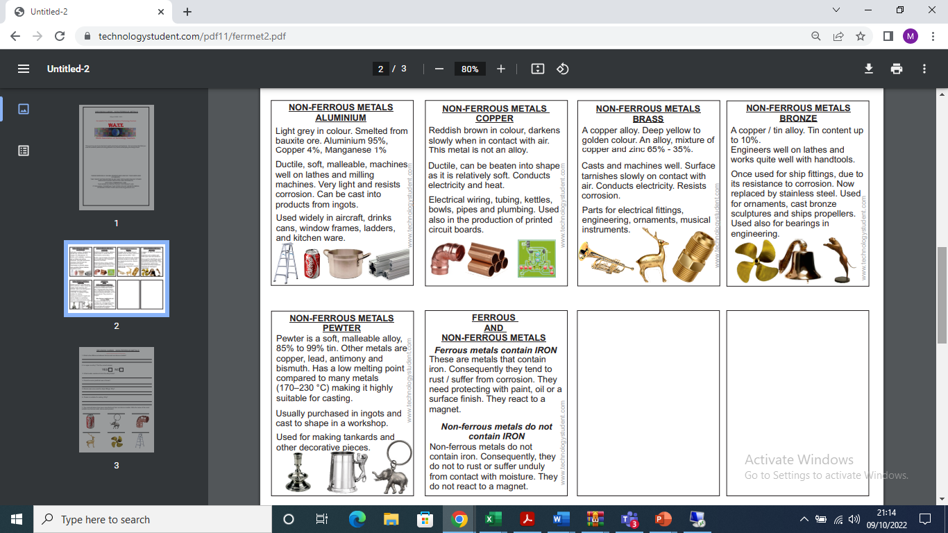
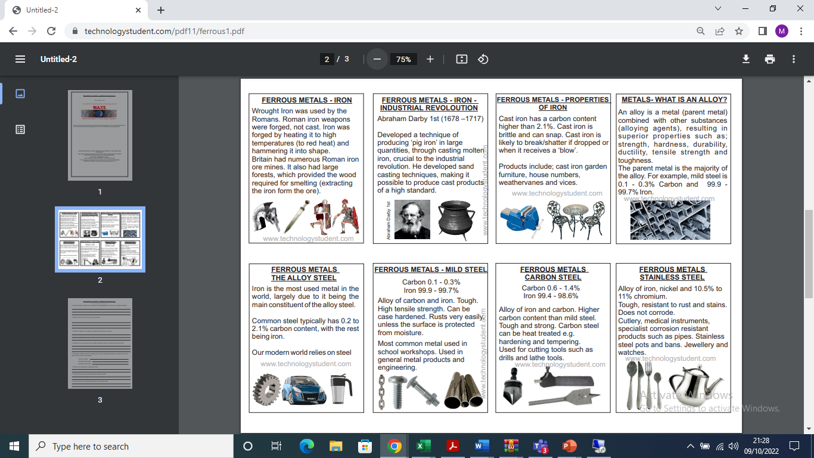
BECOMING AN EXPERT IN DESIGN AND TECHNOLOGY
Metals
Physical Properties
Fusibility
Ability to change into a molten or liquid state when heated.
Density
Mass per unit volume. “Balsa is not a dense wood compared to oak.”
Electrical Conductivity
Low resistance to electric current. I.e Copper
Electrical Insulators
Really high resistance to electric current. Won’t let it flow. Ceramics/Plastics such as PVC
Thermal Properties
How a material reacts to heat. Does is conduct/insulate or expand?
Optical Properties
Transparent → Opaque and everything in between
Properties of Materials
Malleability
Being able to withstand being deformed by compression without failing.
Ductility
The ability of a material to be “drawn out” and stretched uniformly.
Elasticity
Is able to flex and bend but return to normal shape without deformation.
Plasticity
Is able to permanently change shape by external forces without cracking.
Toughness
Being able to withstand being hit with force and remaining intact.
Hardness
Ability to resist abrasive wear and tear, scratches without breaking. Withstand bending
Durability
Is able to withstand wear and tear, weathering, corrosion. Durability stops the material deteriorating and prevents weakening.
Stability
The material resists changes in size and shape due to its surrounding environment. For example, timber will warp and twist because of moisture. Metals and plastics can deform gradually under continual stress. (Known as creep). Stable materials are creep resistant.
Strength
Resist force without breaking. Tensile/Compressive/Bending/Shear/Torsion

Slide 2
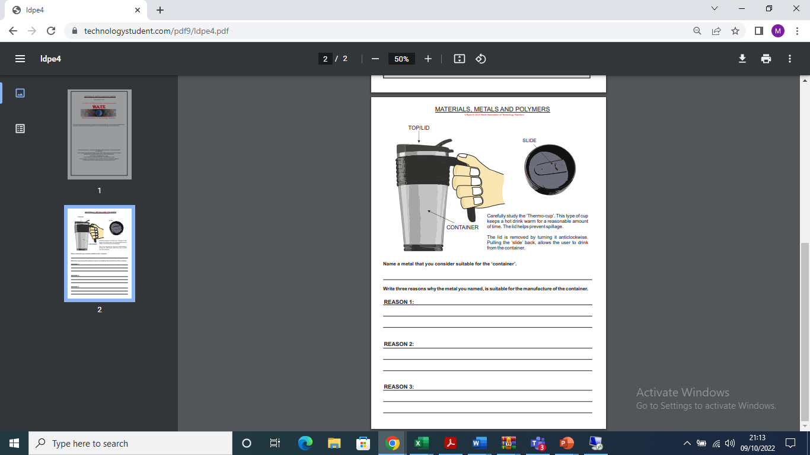
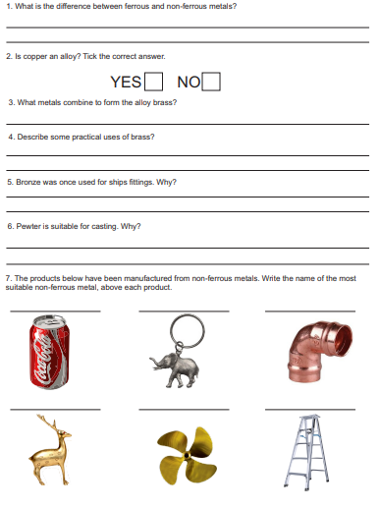
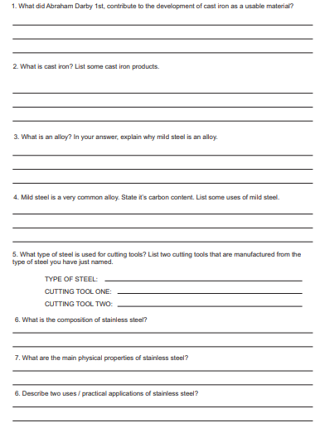
BECOMING AN EXPERT IN DESIGN AND TECHNOLOGY

