Slide 1

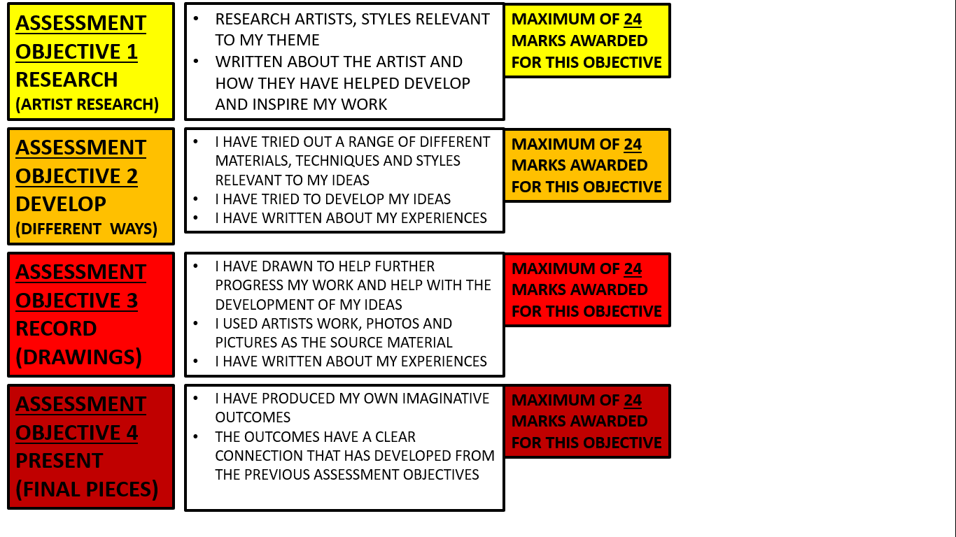
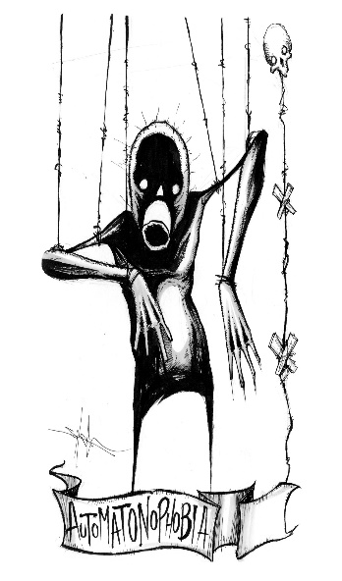
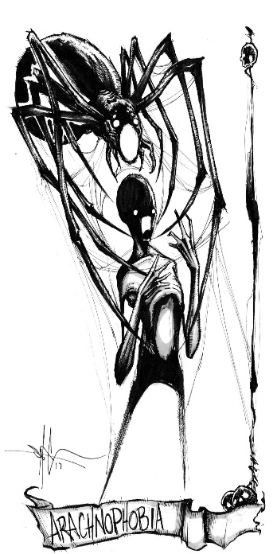
YOUR WORK IS MARKED IN FOUR DIFFERENT WAYS TO GIVE A TOTAL MARK OUT OF 96
PHOBIAS
TALK AND THINK LIKE A THOUGHTFUL ARTIST
EMOTION – THE FEEL OR MOOD OF THE ARTWORK – MIGHT HAVE SOMETHING TO DO WITH THE COLOUR, CONTENTS OR EXPRESSION ON A FACE
TENSION – CREATING A SENSE OF UNEASE IN YOUR WORK, THE BEST EXAMPLES ARE OFTEN SUBTLE OR UNSEEN
MYSTERY – MAKES THE VIEWER OF YOUR WORK ASK SOME QUESTIONS LIKE, WHAT DOES IT MEAN? WHAT ARE THE IDEAS BEIND THE CREATION? WHAT IS HAPPENING HERE?
MESSAGE – THIS MIGHT BE OBVIOUS IN YOUR WORK - OR NOT! IT COMES FROM THE THINKING AND REASONING BEHIND YOUR IDEAS AND THE WAY YOU MIGHT REPRESENT THIS IN VISUAL FORMS
SHAWN COSS
ADDITIONAL INTERESTING THINGS TO EXPAND YOUR KNOWLEDGE AND SKILLS
WHERE DO PHOBIAS COME FROM? YOUTUBE
https://www.youtube.com/watch?v=zmPzvWoE5Xk
SHAWN COSS PHOBIAS ARTWORK – YOUTUBE
https://www.youtube.com/watch?v=ro9JqMmAVcg
HOW TO STOP FEELING ANXIOUS ABOUT ANXIETY
https://www.youtube.com/watch?v=ZidGozDhOjg
THE SECRET TO MENTAL STRENGTH
https://www.youtube.com/watch?v=TFbv757kup4

