Slide 1

MAXIMISE YOUR POTENTIAL
Guided Revision Support Yr11
Class of 2023
The Best You Can Be

Slide 2
Broad Overview of Summer Exams
GCSEs mocks 1
Weeks 7th & 14th November
GCSEs mocks 2
WB 22nd February
UP TO 23 SEPARATE EXAMS
TOTAL OF 50 HOURS OR MORE

Slide 3
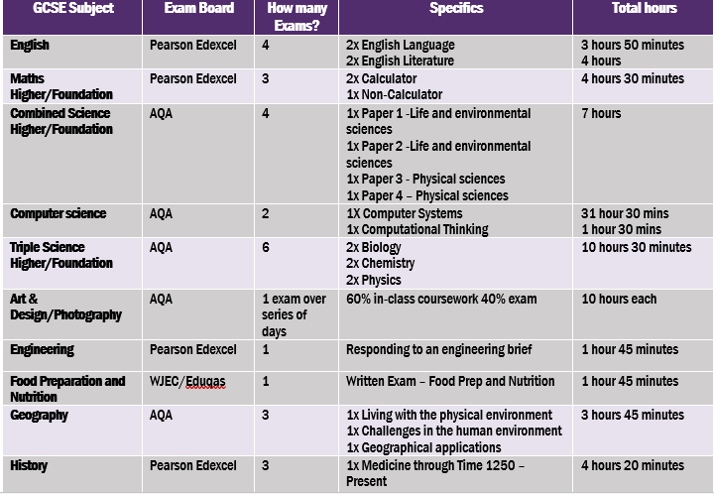
Broad Overview of Summer Exams

Slide 4
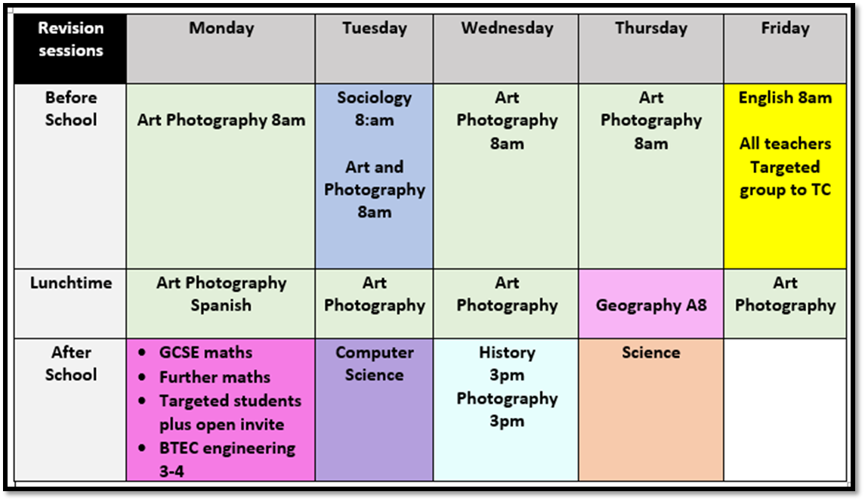
Broad Overview of Summer Exams

Slide 5
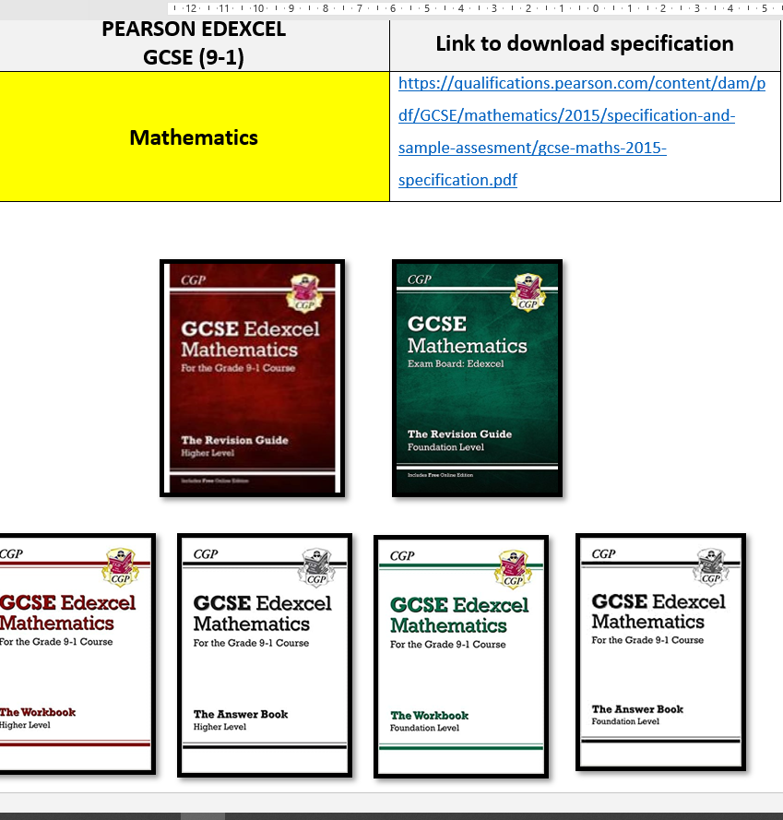

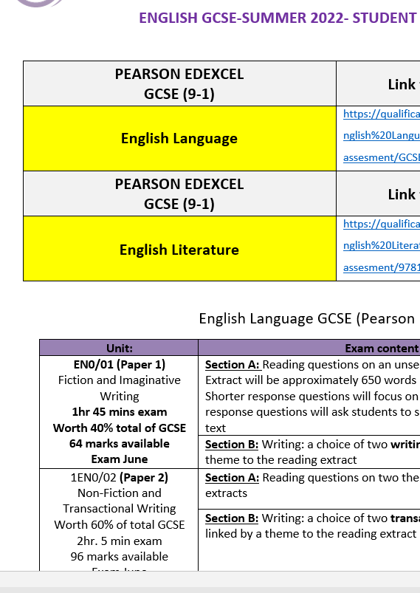
Yr11 MAXIMISE FOLDER
What does this contain for each subject I study?
Exam information sheet:
The structure of each exam in summer and the weighting of each exam
A downloadable link to the exam specification
Success criteria/Mark schemes/marks available
The format of the exam.
Exactly what students need to learn, topics etc. to inform structured revision
Links to revision guides, useful websites/learning platforms
You Tube videos, practice sites such as Tassomi and GCP revision guides,
links to websites

Slide 6
Plan now
Be organised
Be ready
Be confident

Slide 7
MANAGE MY REVISION
2 hours per day on week nights
3 hours each day on Saturdays and Sundays
Mon | Tues | Wed | Thu | Fri | Sat | Sun
 |  |  |  |  | - | -
Revision X2 hours | Revision X2 hours | Revision X2 hours | Revision X2 hours | Revision X2 hours | Revision X3 hours | Revision X3 hours
16 hours= Progress over Time

Slide 8

MANAGE MY REVISION
Research-Little and Often
Revision is best chunked into
30-40 -minute intense sessions at home and school
Huge ‘chunks’ of learning & revision less effective than ‘little and often’.
making the learning faster and longer-lasting.
So revisiting and testing yourself makes learning stronger.
…Make it make sense to you!

Slide 9
MY MAXIMISE FOLDER
YOU NEED TO HAVE THIS WITH YOU EVERY DAY
What is my folder for?
Organisation, information between home and school
Spare wallets
For practise questions, practice papers papers given to you by your teachers, plus any weekly revision lists, knowledge sheets from each subject

Slide 10
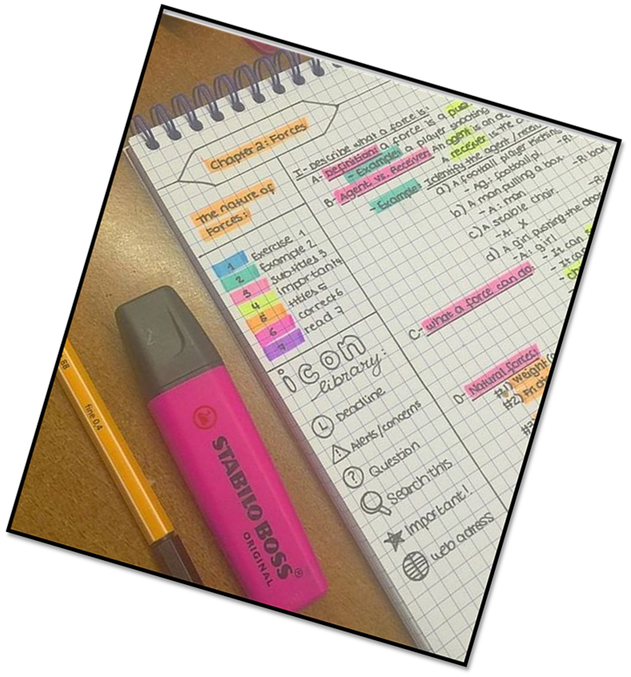
Yr11 MAXIMISE FOLDER
Use folder to collect
resources from teachers
& to keep self made:
Mind maps
Revision cards
Cornell notes
Dual Coding
Note taking

Slide 11
Maximise subject support timings
 | Session 1 5:10-5:30 | Session 2 5:30-5:45 | Session 3 5:45-6:00 | Session 4 6:00-6:15 | Session 5 6:15-6:30 | Session 6 6:30-6:45
Violet Ticket | English | Options | Science | Options | Maths | Options
Yellow ticket | Maths | Options | English | Options | Science | Options
Blue Ticket | Science | Options | Maths | Options | English | Options

Slide 12
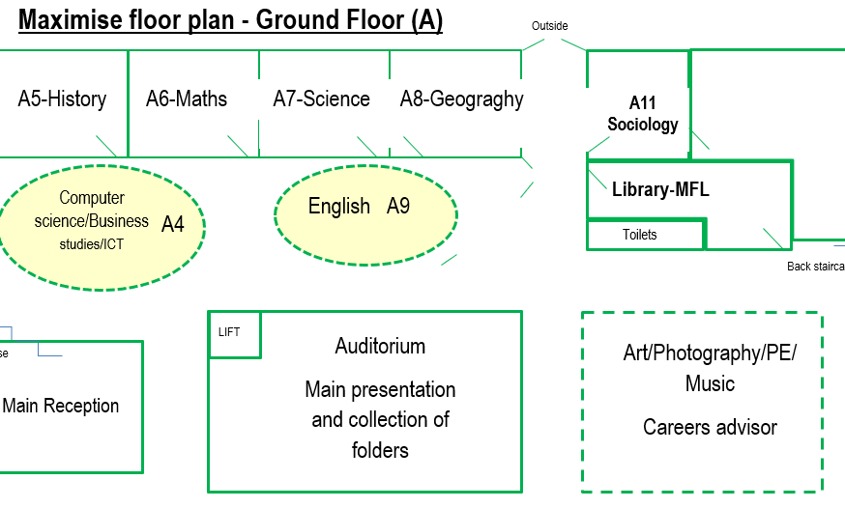

Slide 13
What Now?
Collect your folder. Look at it tonight, show it to your parents, look at the specifications and websites recommended. Also the CGP guides and workbooks
NEXT
Collect resources/revision materials from your teachers
Ask them, make sure you get as much as you can this week and next
Attend all revision sessions on offer. Your teachers are your best resource
Start your 5 a day revision and daily practise

Slide 14


