Slide 1




Notes:
From fontspace.com.
Font is called Orange slices

Slide 2
If there is one that needs a school-based account that you don’t have, speak to your Spanish teacher.
Scan the QR code or copy down the link to get to the website.

Slide 3
There may be age restrictions on ones that need an account (usually 12/13) – please check with your parents if unsure.

Slide 4
I want to do some more Spanish - not just school stuff

Slide 5
I want to do more practise of what we are learning

Slide 6



Listen to vocab, match up, type answers, log progress, save scores & compete.
Search 1000s of sets of vocab on 1000s of topics
Free (can use without
an account but tracking is better with one)
www.quizlet.com
KS3
KS4
KS5

Slide 7



Search 1000s of topics (or use links from school) to play fun games to practise keywords.
Compete in class contests.
Free -account needed
to use independently.
www.blooket.com
KS3
KS4
KS5

Slide 8



Loads of languages.
It builds up structures & vocab in a game-like way.
Audio to help listening.
Track progress, win
points and compete with others.
Free but you have to
make an account.
www.duolingo
.com
KS3
KS4
KS5

Slide 9



Topic based practice
with several languages
Search e.g. ‘Spanish KS3’ ‘Spanish Eduqas GCSE’
Pick topics you’ve been doing to broaden vocab or choose new ones.
Free but need an account so it can track progress.
www.seneca
learning.com
KS3
KS4
KS5

Slide 10


You can use independently.
Several languages.
Useful things include:
Verb trainer – tenses etc.
Vocab / Boxing – words
Workouts / Rock climbing
- sentence practice
Accounts from teachers.
https://uk.language-gym.com
KS3
KS4
KS5

Slide 11



Use independently to revise or pre-learn topic vocab, for skills practice (listening / reading / writing) and exam practice.
Audio to help with your listening skills.
www.gcsepod
.com
KS4

Slide 12



Worried about your pronunciation?
Paste in text in Spanish (or other language), select that language and then click ‘say it’ to hear the correct pronunciation.
(spell everything right!)
Don’t need an account.
https://text-to-speech.imtranslator.net
KS3
KS4
KS5

Slide 13



Very reliable online dictionary – gives you examples in sentences.
You can ask it to ‘speak’
it to check pronunciation.
Has a useful conjugation tab to check verb forms.
Can get an app for it too.
Don’t need an account.
https://dictionary
.reverso.net
/english-french/
(& other langs)
KS3
KS4
KS5

Slide 14

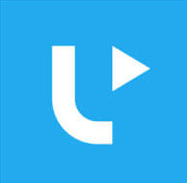

Find songs you like in Spanish or another language.
Look up the lyrics online and then do gap fill
games to help you learn the words. Also an app.
Free – don’t need an account but it’s useful.
www.lyricstraining.com
KS3
KS4
KS5

Slide 15



If you need to memorise something, copy and paste paragraphs and it will delete some words
or give you just the first
letters to help you practise it with less and less support.
Don’t need an account.
www.memorize
now.com
KS3
KS4
KS5

Slide 16





Practise independently
by topic area or grammar point.
Exam style practice tasks
Audio helps with your listening skills.
Several languages.
Don’t need an account.
KS3
KS4
KS3
KS4
https://www.bbc.co.uk/bitesize/subjects/z2nygk7
https://www.bbc.co.uk/bitesize/subjects/zhsvr82

Slide 17
1. Find a Spanish song on Youtube and learn the lyrics. | 2. Visit https://Frogplay.net and practise any topic area, completing the exercises and quizzes | 3. Follow a Tasty Recetas video recipe for paella, gazpacho or a Spanish dish of your choice. Can you make it? Did you enjoy it? Write up your opinions and reasons in Spanish https://www.tastyrecetas.com/paella-de-marisco/ | 4. Visit https://www.linguascope.com Username and password - ephsmfl adios! Play the games and do the end of unit test for a topic of your choice. | 5. Visit the famous Spanish museum: ‘El Prado’ https://www.museodelprado.es/en In Spanish, write about which paintings you liked/disliked and why. | 6. Watch a Spanish film on Netflix/Prime- (examples attached) you can use English subtitles. OR watch a film you know well and change the language/subtitles to Spanish.
7. Search ‘Spanish revision’ on Pinterest and create a new board. Try three suggested ideas. | 8. Learn Spanish through a FREE Podcast: https://radiolingua.com/coffeebreakspanish/ | 9. After 4pm use this learning website for free: https://oye.languageskills.co.uk/index.html | 10. Watch a topical news video and summarise the key points in English https://www.newsinslowspanish.com | 11. Visit https://www.marca.com/ have a look at the first article. Which sport is being discussed? What is the article about? | 12. Use the vocabulary from Frogplay/ Linguascope to create a worksheet or picture dictionary.
13. Teach some Spanish vocabulary to a sibling/family member. | 14. Learn the lyrics to a Spanish song https://lyricstraining.com/play/alvaro-soler-jennifer-lopez/el-mismo-sol-lyrics/HnMdGuRXhn#b7w | 15. Research a Spanish speaking (not Spain) country and produce a presentation all about it. | 16. Make flashcards for vocabulary from Linguascope/Frogplay | 17. Listen to a Spanish playlist on Spotify: https://open.spotify.com/user/oreobubblez/playlist/32zAUaYOXlXaTnRCF6YZro?si=ZpaKCX8LQOeNG0TQezCp3Q | 18. Record yourself speaking Spanish on a video. Present about the topics you’ve learnt recently.
19. Download Duolingo and study Spanish for 10 minutes a day. | 20. Create a quiz on Kahoot about a Spanish topic. Use Frogplay/Linguascope to help. | 21. Watch a Children’s show in Spanish. E.g. Peppa Pig (you can turn on the English subtitles) Write down any words you recognise. | 22. Research Careers that you could do using Spanish- Produce a Presentation about them. | 23. Learn new vocabulary through Quizlet. https://quizlet.com | 24. Research a festival and how it’s celebrated in Spain and how it’s different to the UK: Easter, Christmas, Eid, Pancake day.

Slide 18
25. Text or Whatsapp a friend in your class in Spanish | 26. Have a look at these Spanish fast-food websites. Have a look at the ingredients What would you order? Write a paragraph in Spanish: https://www.burgerking.es/carta | 27. Use Memrise (app) to learn new vocabulary | 28. Research Spanish food/dishes. Design a menu for a dinner party in Spanish. Starter, Main course and Dessert. Or design a tapas menu. | 29. Design an outfit for a special occasion, label it in Spanish and write a description. You could cut out clothes from an old magazine or newspaper | 30. Research a famous Spanish person (film star, sports person, musician, scientist) and produce a biography in Spanish.
31. For each letter of the alphabet find a food, adjective, place, boys name, girls name, animal in Spanish. | 32. Play FIFA all in Spanish. | 33. Research a famous Spanish landmark and create a presentation: The Alhambra, la Sagrada Familia, el Prado museum, Royal Palace of Madrid. | 34. Use www.Word.Reference.com to write out a shopping list in Spanish. | 35. Follow iscoalarcon or claralago1 on instagram. What is their most recent post about? Have a go at translating it, then try the ‘translate’ button. How close were you? | 36. Read and translate some reviews on TripAdvisor for a local city https://www.tripadvisor.es
37. Choose a Spanish story to Read/Listen to. You can translate the sentences to help you using the website. https://www.thespanishexperiment.com/stories | 38. Practise your Spanish grammar by completing the exercises online. https://www.languagesonline.org.uk/Hotpotatoes/spanishindex.html#Grammar | 39. Have a look at a map of Spain. Research a Spanish city of your choice- Create a presentation about the city. | 40. Visit www.Languagesonline.com choose ‘Español’ - vocabulary – preguntas (then choose either desktop or mobile) and complete the exercises. | 41. . Learn some Spanish tongue twisters: https://uk.video.search.yahoo.com/yhs/search?fr=yhs-domaindev-st_emea&hsimp=yhs-st_emea&hspart=domaindev&p=spanish+tongue+twisters+youtube#id=3&vid=3d60f4b240f2b542353cffe3ec6adc45&action=click | Create an origami Sagrada Familia. https://www.youtube.com/watch?v=wfA21floEgA

Slide 19
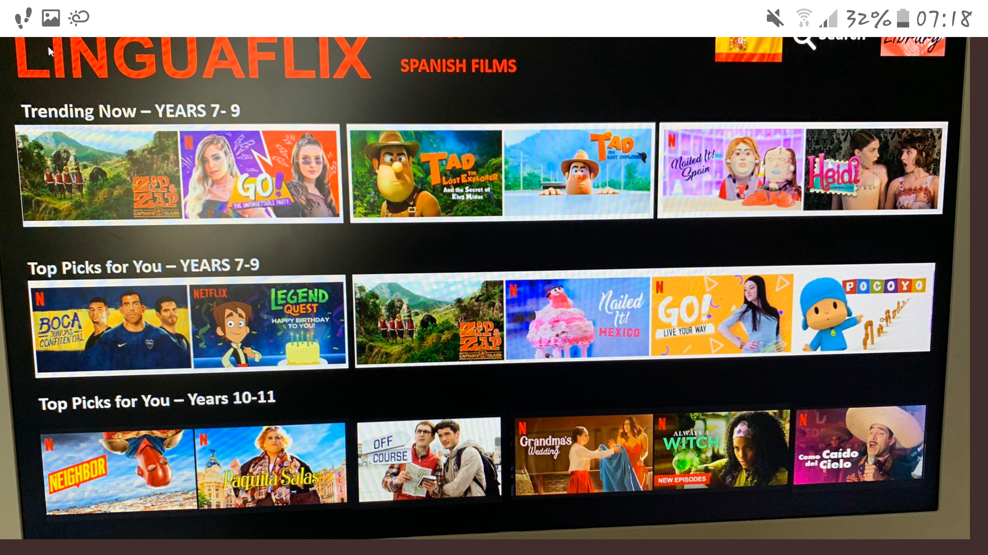
U
U
U
PG
PG
U
PG
PG
U
PG
U
U
TEEN
15
12
12
15
15
SOME SERIES TO GET YOU STARTED.
FOUND MORE?
LET ME KNOW!

Slide 20
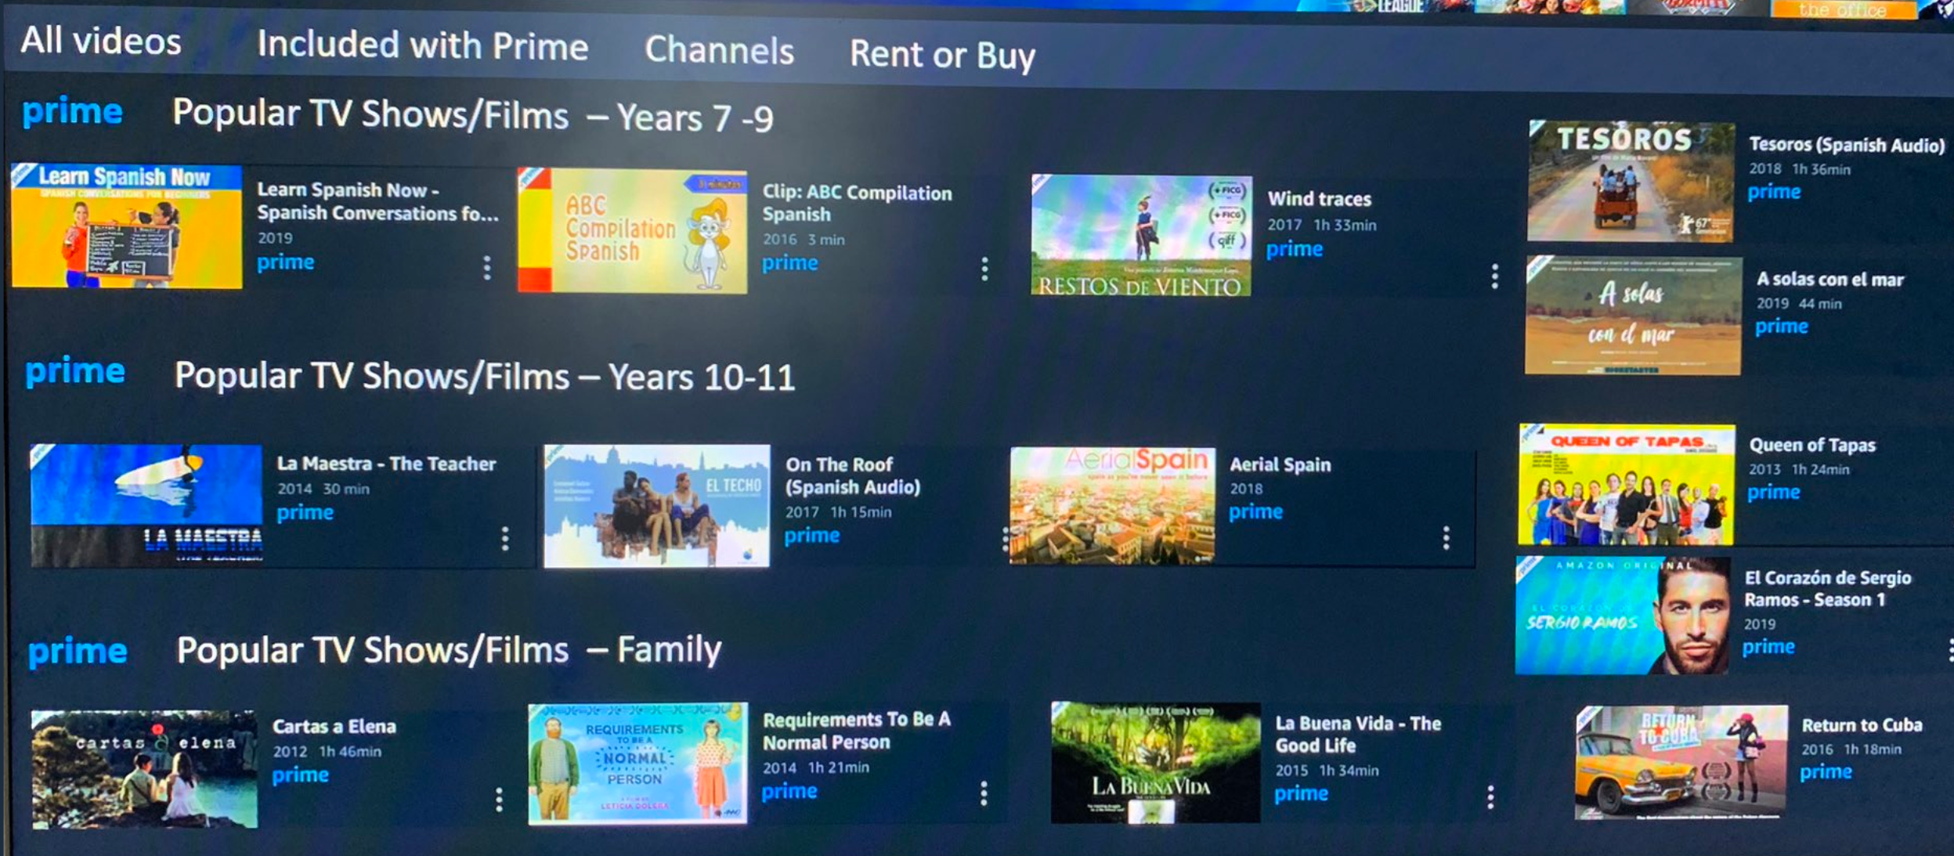
13+
7+
ALL
ALL
ALL
ALL
NO LONGER AVAILABLE
13+
7+
15
PG
ALL
13+
13+
SOME SERIES TO GET YOU STARTED.
FOUND MORE?
LET ME KNOW!

Slide 21
https://www.netflix.com/gb/title/81062582 Nailed it https://www.netflix.com/gb/title/80990609 Neighbor (15)
https://www.youtube.com/watch?v=yRu0Z6dhLQ4 Boca confidential
https://www.youtube.com/watch?v=EpP3Al2GaB8 Siempre bruja
https://www.youtube.com/watch?v=i8Vb3E8i_J0 Go! La fiesta inolvidable
https://www.youtube.com/watch?v=Mf9EhWmmp9U Requirements of being normal (13+)
https://www.youtube.com/watch?v=wq9YwfhElh8 El Corazon de Sergio Ramos (15)
Notes:
Trailers for some of the progs from last 2 slides – get watching over the summer!!

