Slide 1

Science

Slide 2
Week beginning Nov 5th for approximately 2 weeks.
Mock
Exam
Date
Combined = 2 exams
Triple = 3 exams
How many?
Revision lists tonight ☺
Each exam is 1hr 45 minutes.
How long?
Remember homework and revision sessions

Slide 3
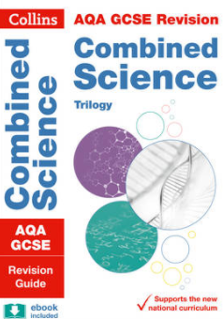
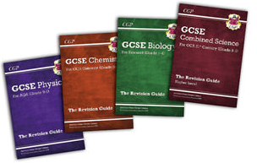
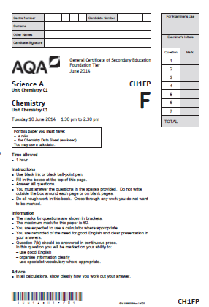

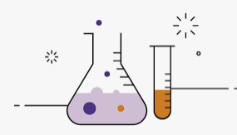
Want to ace your science exam?
Step 1
Buy a revision book ☺
Read the notes, make some flash cards and try the questions at the back – mark scheme included ☺.
Step 3
Make sure you regularly use your maximise folders and do homework set by your teacher. Attend revision sessions.
PRACTISE, PRACTISE, PRACTISE!
Past paper practise is really valuable to prepare for your test/exam – You will have at least 2 already in the maximise folders.
Go to BBC Bitesize- make a list of any questions you have and ask your teacher about them.
Step 4
Step 2
Or ...
http://freesciencelessons.co.uk/
https://cognitoedu.org/home.html

Slide 4
Recall – flash cards, video clips, reading notes in a book or online
Ready…
Rehearse – practise questions, revision book questions, download questions from AQA, download from website in checklists. Use maximise folder.
Steady…
REPEAT ☺
Rest – take a break, have a drink/snack, 10 minute chat with a friend
Go…
Remember the 4 R’s!

Slide 5
Is there somewhere calm/quiet for them to study
Have they made a plan/timetable?
Is revision part of the routine?
Are they stressed/need support?
Do they know what to revise & where to get the information?
Do they need a snack!?
Do they need a gentle shove in the right direction!?
Be encouraging
/praise often.
SOMETHING TO THINK ABOUT…

Slide 6

Questions?

