Slide 1

VIBRANT INCLUSIVE PROUD
GCSE Language and Literature
An overview of:
Structure of the Language GCSE
How to revise the Language component
Structure of Literature GCSE
How to revise the Literature component
“If I read a book and it makes my whole body so cold no fire can ever warm me, I know that it is poetry.” – Emily Dickinson

Slide 2
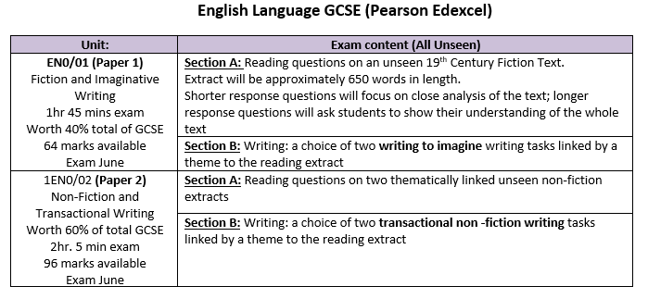
VIBRANT INCLUSIVE PROUD

Slide 3
VIBRANT INCLUSIVE PROUD
Paper 1 (1 hour 45 minutes)= 64 marks
Part A- Reading= 24 marks
Q1. Short form answer (1 mark)
Q2. Short form retrieval (2 marks)
Q3. Language and structure analysis (6 marks)
Q4. Evaluate (15 marks)
(45 minutes)
Part B- Imaginative Writing= 40 marks
Q5 or 6.
Assessed on SPaG + vocabulary + structure
(1 hour)
Exam tip:
Writing is key on this paper.

Slide 4
Paper 2 (2 hours 5 minutes)= 96 marks
Part A- Reading= 56 marks
Q1. Short form answer (1 mark)
Q2. Short form retrieval (2 marks)
Q3. Language and structure analysis (15 marks)
Q4. Short form answer (2 marks)
Q5. Short form comment (2 marks)
Q6. Evaluate (15 marks)
Q7a. Compare similarities (6 marks)
Q7b. Compare similarities and differences (14 marks)
(1 hour 15 minutes)
Part B- Transactional Writing= 40 marks
Q8 or 9.
Assessed on SPaG + vocabulary + structure
(50 minutes)
Exam tip:
Time management is key on this paper.

Slide 5
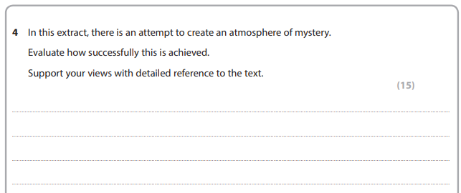
VIBRANT INCLUSIVE PROUD
What does a long form question look like? (Paper 1)

Slide 6
What does a long form question look like? (Paper 2)
Analyse how the writer uses language and structure to interest and engage readers.
In your answer you should write about:
Language features and techniques
Structural techniques
The effect on the reader
Support your views with detailed reference to the text.
(15)
Exam tip:
This question is always the same.

Slide 7
VIBRANT INCLUSIVE PROUD
How do you revise English Language?
These skills can be applied to any type of reading. Play to your strengths; wider reading can be anything that you are interested in.
Reading is key and using reciprocal reading skills
  Predicting
  Clarifying
  Questioning
  Summarising

Slide 8
VIBRANT INCLUSIVE PROUD
How do you revise English Language?
Exam top tips:
Practise past exam papers
Make sure you do this under timed conditions
Use the mark scheme afterwards to see your strengths and areas for development
PLAN, PLAN, PLAN different kinds of stories/ writing
Key websites:
https://www.bbc.co.uk/bitesize/examspecs/zgvg6fr
https://senecalearning.com/en-GB/blog/gcse-english-language-revision/

Slide 9
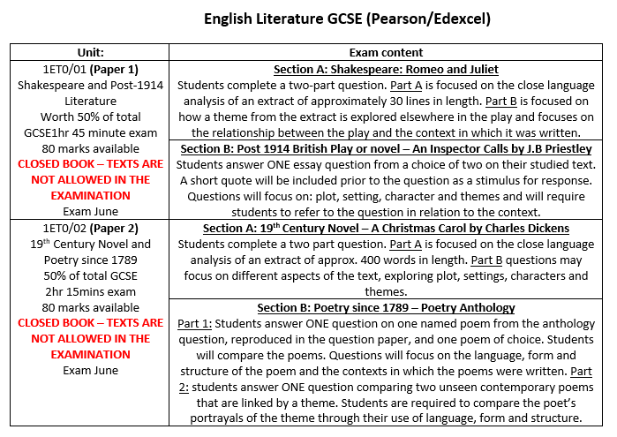
VIBRANT INCLUSIVE PROUD

Slide 10
Paper 1: Shakespeare and Post-1914 Literature
(1 hour 45 minutes)= 80 marks
Section A: Romeo and Juliet
Part A (20 marks)
Analyse language, form and structure based on an unseen extract from the play
Must only mention the extract
Part B (20 marks)
Discuss the given theme and its effect in the play
Must give contextual information
Must not mention the extract
Section B: An Inspector Calls
Choice of two questions
Only answer one
16 marks for responding to the play
16 marks for context (social/political/historical)
8 marks for SPaG

Slide 11
Paper 2: 19th Century Novel and Poetry
(2 hours 15 minutes)= 80 marks
Section A: A Christmas Carol
Part A (20 marks)
Analyse language, form and structure based on an unseen extract from the play
Must only mention the extract
Part B (20 marks)
Discuss the given theme/character/setting and its effect in the novel
Must not mention the extract
Section B: Poetry (Seen and Unseen)
Part A (20 marks)
Given one poem from the anthology and must compare to another
Analyse language, structure and form (+ themes)
Must include some context
Part B (20 marks)
Given two poems (unseen) and must compare
Analyse language, structure and form (+ themes)

Slide 12
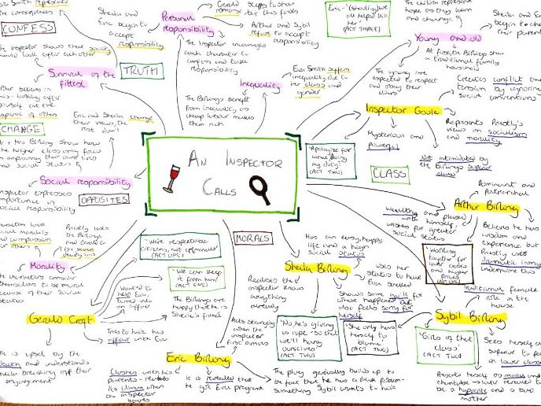
Mindmaps
The best way to use these is over time.
Start blank and write down everything that you know.
After completing some revision, add to what you know (in a different colour).
Repeat this process.
Writing in a different colour will show you the newer knowledge that you need to rehearse more.
Once you have a completed version:
Memorise it
Write from scratch
Check it
Add to it
This promotes long-term memory gains.

Slide 13
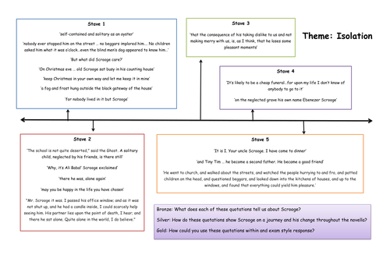
Timelines
Timelines help you order your knowledge
Start with ‘Stave 1’ or ‘Act 1’
Write down the key events that happen
Write down the characters that you meet
Build on this:
Add key quotes
Add key themes

Slide 14
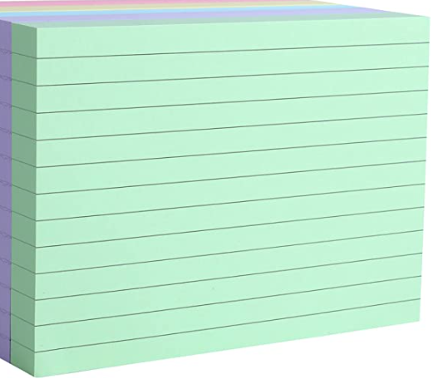
Flashcards
Key quote
Summarise the quote (in your own words)
Label the technique
Select key/ interesting words
Reader thinks (image created)
Reader feels (emotional response)
Exam tip:
Flip the card over and re-write the quote in the middle
Read the quote
Say out loud to yourself what it says on the other side (without looking)
Turn it over and check what you remember
RAG it: red (didn’t remember much); amber (remembered half); green (nailed it)

Slide 15
VIBRANT INCLUSIVE PROUD
Revision Sessions
Every Friday morning
Every English teacher will be available
Separate cohort for TCR
Timetable up until Christmas
Revision resource and materials to be provided- must be kept in the maximise folder

Slide 16
VIBRANT INCLUSIVE PROUD

