Slide 1

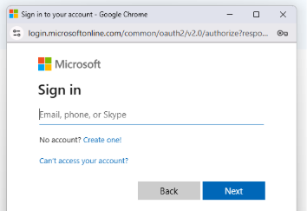
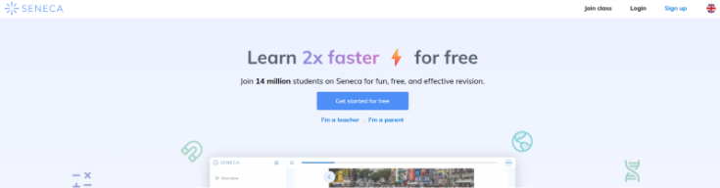
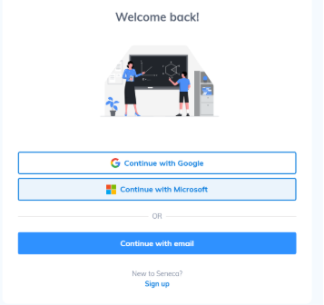

Instructions for Seneca Access for Homework
Search Seneca on google OR visit https://senecalearning.com
Click login in the top right corner
Enter your school email which follows the format:
ephfirstname.lastname@consilium-at.com
3. Click Continue with Microsoft
5.On the next screen you will be asked for your password which is the same as you use in school for their computer login (it is likely 3 words with full stops in between them)
e.g.
Know.Your.Code
That’s it! You are in!

